Slide 1





UNIVERSITY LIBRARY MANAGEMENT SYSTEM
Group no: 09

Slide 2

Introduction
This project is a library management System built with the MERN stack to streamline book borrowing, returning, and tracking. It features user authentication, role-based access, QR code scanning, and an admin dashboard for efficient management. The system enhances user experience with a responsive UI and modern technologies, ensuring seamless library operations.

Slide 3

Why this is important?
Traditional library management systems require manual effort, leading to inefficiencies.
Students face difficulties in searching for and accessing books.
Lack of an online borrowing system results in unnecessary physical visits.
Administrators struggle with tracking borrowed books and managing library inventory.
Need for a digital solution that simplifies library operations for both users and admins.

Slide 4


Technologies
Frontend: React.js (for interactive UI)
Backend: Node.js & Express.js (for server-side operations)
Database: MongoDB (to store users and books data)
Authentication: JWT (for secure user authentication)
QR Code System: QR Code Scanner (to manage book borrowing/returning)
Cloud Storage: For e-books and past paper downloads
R
Title: Technologies ImplementedContent:
Frontend: React.js (for interactive UI)
Backend: Node.js & Express.js (for server-side operations)
Database: MongoDB (to store user and book data)
Authentication: JWT (for secure user authentication)
QR Code System: QR Code Scanner (to manage book borrowing/returning)
Cloud Storage: For e-books and past paper downloads
Notes:
The MERN stack is a combination of four technologies:MongoDB - A database that stores data.
Express.js - Handles backend logic and APIs.
React.js - Manages the frontend interface (what users see).
Node.js - The environment where the backend code runs.

Slide 5


Objectives
Streamline Library Operations—Simplify book borrowing, returning, and tracking.
Implement Secure Authentication—Ensure safe access with JWT-based login and role-based permissions.
Enhance User Experience—Provide an intuitive and responsive interface using Material-UI.
Enable QR Code Integration—Speed up book transactions with QR scanning technology.
Improve Administrative Control – Equip admins with tools to manage books, users, and borrowing records efficiently.
Ensure Scalability—Develop a system that can expand with increasing users and books.

Slide 6
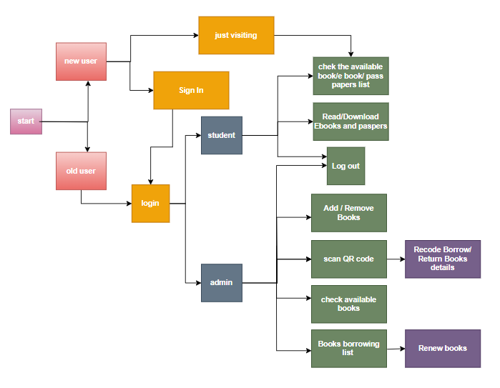

System architecture

Slide 7

Features
Features for UsersContent:
User Registration & Login: Sign in with university email.
Home Page: Displays about details, contact info, and links to book-related pages.
Available Books: Search and borrow physical books.
E-books Section: Read and download e-books.
Past Papers: View and download previous exam papers.

Slide 8

Features con’t
Features for AdminContent:
Admin Login: Secure access with a special email and password.
Admin Dashboard: Access to different management pages.
Total Books: View all books with downloadable QR codes.
Manage Books: Scan QR codes to issue or return books.
Add New Books: Add books with images, authors, ISBN, and descriptions.
Released Books: Track borrowed books with student details and deadlines.
Extend Borrowing: Allow students a one-time extension of one week.
8

Slide 9

THANK YOU!
2021/T/01127- A.V.W.Jayawardena
2021/T/01179 -G.M.Vithanage
2021/T/01126 -M.H.D.M.Jayasinghe
Git --- https://github.com/AvishkaVishwa/FOT-Library-Management-System.git
Drive -- https://drive.google.com/drive/folders/1Up42ofYsYVXxAKzo5bBt_wk9reiyVzRJ?usp=sharing

